Slide 1



SQL PROJECT
BY PALLAVI JAIN
JAINPALLAVI225@GMAIL.COM

Slide 2



DESCRIPTION
The Life Insurance Corporation (LIC) of India is the largest and oldest insurance provider in the country, established in 1956. Known for its reliability and trust, LIC plays a pivotal role in securing the financial future of millions of Indians through its wide range of policies. It has been a cornerstone of India's financial sector, combining comprehensive coverage with a deep commitment to customer welfare and societal growth.
This project involves designing and implementing a relational database system to analyze and optimize data management for the Life Insurance Corporation (LIC) of India. The database consists of three interconnected tables: POLICYHOLDERS ,POLICIES and CLAIMS, which capture essential information about customers, their insurance policies, and claim transactions.

Slide 3


OBJECTIVES
Performance Analysis: You could evaluate trends like policy sales growth, claims settled versus claims raised, and identify patterns or anomalies in premium collections.
Understanding Insurance Data: Analyze structured data related to policyholders, premium payments, claims, coverage types, and beneficiary details.
Customer Segmentation: Using SQL, you can categorize customers based on their policy types, payment history, or demographics, enabling LIC to target specific groups for better service and marketing.
Operational Efficiency: The project could focus on identifying bottlenecks in LIC’s processes, such as claim settlements or policy renewals, and suggest data-driven improvements.
Visualization & Reporting: Using SQL, you can create summary tables or connect the database to visualization tools for generating dashboards that showcase key metrics for stakeholders.

Slide 4
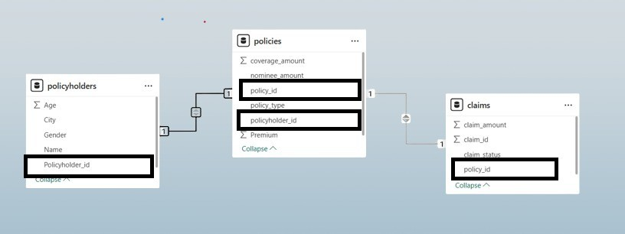

ENTITY RELATIONSHIP DIAGRAM (ERD)

Slide 5

DATASET WITH TABLES Table 1:Policyholders
Policyholder_ID (Primary Key) | Name | Age | Gender | City
1 | Ankit Sharma | 35 | Male | New Delhi
2 | Pallavi Das | 42 | Female | Mumbai
3 | Ravi Kumar | 28 | Male | Bengaluru
4 | Priya Verma | 38 | Female | Chennai
Table 2:Claims Claims
Claim_ID (Primary Key) | Policy_ID (Foreign Key) | Claim_Amount | Claim_Status
201 | 101 | 100000 | Approved
202 | 102 | 50000 | Pending
203 | 103 | 150000 | Rejected
204 | 104 | 300000 | Approved

Slide 6
DATASET WITH TABLES Table 3: Policies
Policy_ID (Primary Key) | Policyholder_ID (Foreign Key) | Policy_Type | Premium | Coverage_Amount | Nominee_Name
101 | 1 | Life Insurance | 2000 | 500000 | NULL
102 | 2 | Term Insurance | 3000 | 300000 | NULL
103 | 3 | Term Insurance | 1500 | 1000000 | NULL
104 | 4 | Life Insurance | 2500 | 600000 | NULL

Slide 7
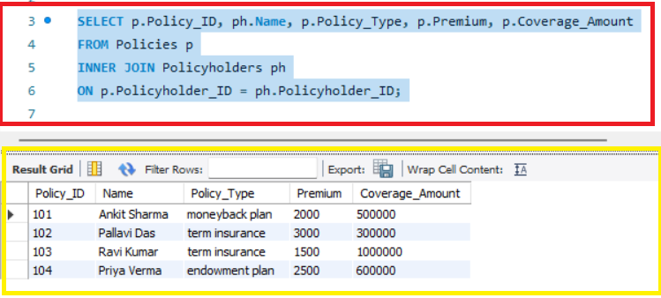

Here’s the updated SQL project with a brief conclusion for each query to highlight the insights gained: Q1. Retrieve all policy details along with policyholder names. Conclusion: This query combines policy and policyholder details to provide a clear overview of who owns which policy and its associated attributes.

Slide 8
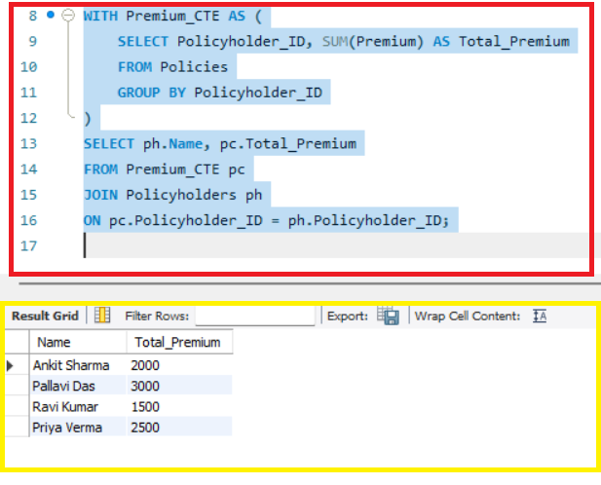

Q2. Find total premium paid by policyholders using a CTE. Conclusion: Using the CTE, this query calculates the total premium contribution by each policyholder, giving insights into revenue distribution.
This Photo by Unknown Author is licensed under CC BY-SA-NC

Slide 9
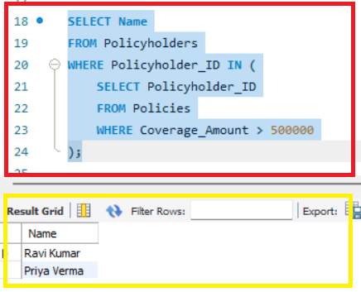

Q3. Retrieve policyholders who have policies with coverage greater than 5,00,000. Conclusion: This query helps identify high-value customers whose policies exceed a significant coverage amount, aiding in targeted customer engagement.

Slide 10

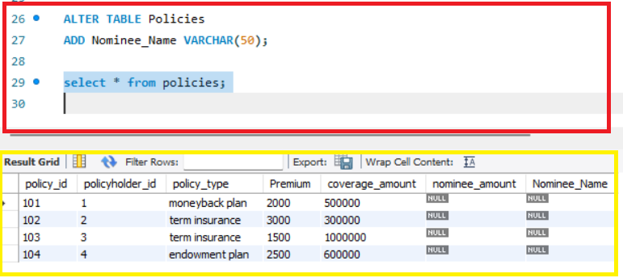
Q4 Add a new column Nominee_name to the Policies table. Conclusion: The column adds more depth to the data, allowing policyholders to specify their nominees, which is critical for insurance processing.

Slide 11

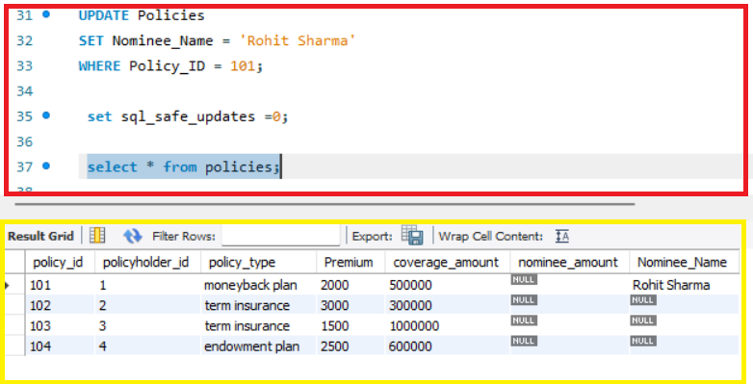
Q5. Update Nominee_Name for policy ID 101. Conclusion: By updating the nominee for a specific policy, this query reflects real-time changes, ensuring accurate and actionable data.

Slide 12
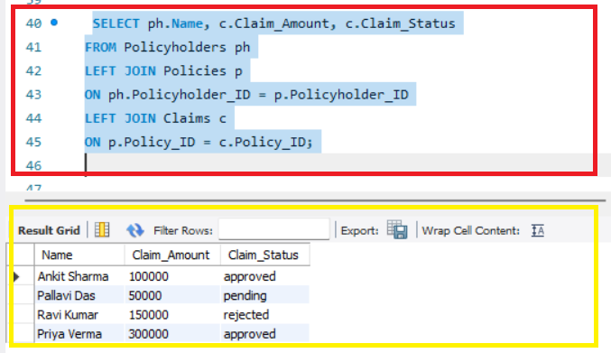

Q6. List all policyholders and their claims status (including those without claims). Conclusion: This query ensures no policyholder is left out, presenting a comprehensive view of claims data while including customers without claims.

Slide 13

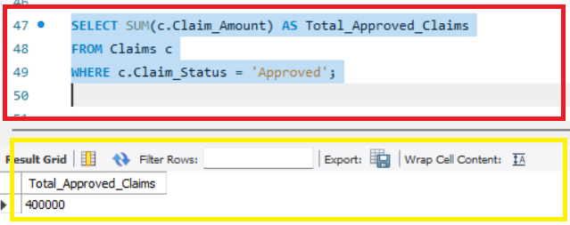
Q7. Calculate the total claim amount for approved claims. Conclusion: This aggregation provides a quick summary of the financial liability for approved claims, supporting budget planning and decision-making.

Slide 14

Through this project, the database design and SQL queries effectively demonstrated how to manage and analyze complex data related to insurance operations.
This SQL project exemplifies the practical application of advanced database techniques—joins, subqueries, CTEs, and updates—highlighting their relevance in real-world business scenarios like insurance management. It establishes a foundation for creating dynamic dashboards and further expanding analytical capabilities

Slide 15


